Slide 1
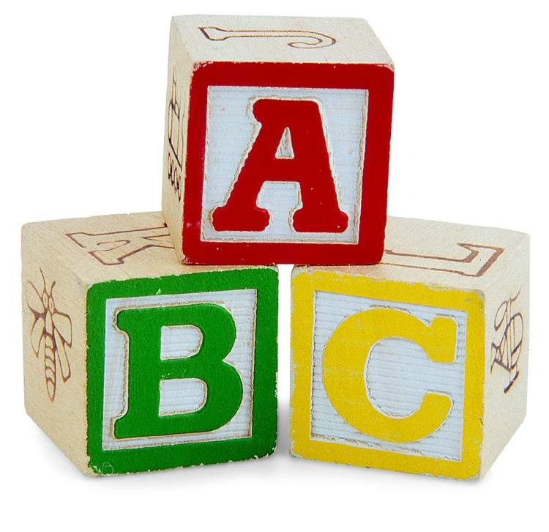
L’alphabet français The French Alphabet

Slide 2
pronounced:
(ahhh)

Slide 3
pronounced:
(bay)

Slide 4
pronounced:
(say)

Slide 5
pronounced:
(day)

Slide 6
pronounced:
(uh)

Slide 7
pronounced:
(eff-uh)

Slide 8
pronounced:
(jjay)

Slide 9
pronounced:
(osh)

Slide 10
pronounced:
(ee)

Slide 11
pronounced:
(jjjee)

Slide 12
pronounced:
(kah)

Slide 13
pronounced:
(ell-uh)

Slide 14
pronounced:
(emm-uh)

Slide 15
pronounced:
(enn-uh)

Slide 16
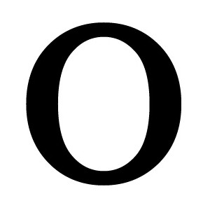
pronounced:
(oh)

Slide 17
pronounced:
(pay)

Slide 18
pronounced:
(coo)

Slide 19
pronounced:
(air-uh)

Slide 20
pronounced:
(ess-uh)

Slide 21
pronounced:
(tay)

Slide 22
pronounced:
(ewww)

Slide 23
pronounced:
(vay)

Slide 24
pronounced:
(doobl-uh vay)

Slide 25
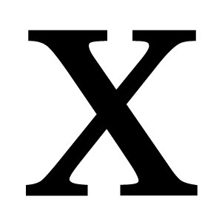
pronounced:
(eeks)

Slide 26
pronounced:
(eee-grek)

Slide 27
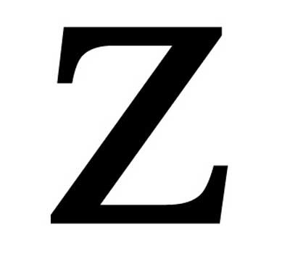
pronounced:
(zed)

Slide 28
Maintenant je les connais
Toutes les lettres de l’alphabet

